Slide 1
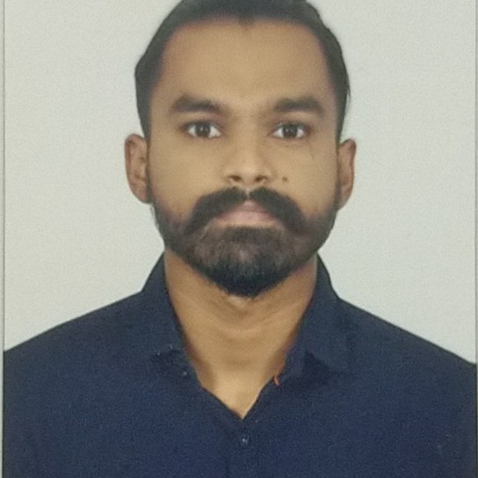
Nihal Vernekar
Analyst/Software Engineer
Bachelor of Engineering in
Computer Science
2017 - 2021
Mumbai
Skills
nihal.vernekar@capgemini.com
+91 8495946244
Backend | Java Basics, OOPS, Generics, Collections, Arrays, Loops and Stream API
Framework | Spring Boot, Spring Core, Spring Data JPA
Frontend | Components, Hooks, Event handling, Redux, Reducers, Testing using Jasmin & Karma
Database | PostgreSQL and MongoDB
Tools | Git, Postman, Gradle, IDE
A4
Full Stack Developer trained on Java Hands on experience in
Core Java
Spring Framework
Git and GitHub
JPA with Hibernate
MongoDB and Postgres
HTML, CSS and JavaScript
React
Project on IPL Fantasy League
g

